Slide 1

RUNGTA COLLEGE OF DENTAL SCIENCES AND RESEARCH
Dental Cast Surveyor and Surveying Procedure.Path of insertion and Removal
Part 1
Dept of Prosthodontics
3rd Year BDS
Presented By:
Dr.Shilpi Karpathak
Professor
Dept of Prosthodontics

Slide 2
Specific Learning Objective
Core areas | Domain | Category
Introduction Definitions Surveyor types , parts , uses | Cognitive | Must Know
Surveying the diagnostic cast Surveying the master cast Survey lines | Cognitive | Must Know
 | Psychomotor | Must Know
Summary | Affective | Must Know

Slide 3
contents
Introduction
Definitions
Surveyor types , parts , uses
Surveying the diagnostic cast
Surveying the master cast
Survey lines
Summary
references

Slide 4
Introduction
A standard dental arch for which a removable partial denture is to be constructed is made of remaining natural teeth in varying angulations and edentulous space/s of varying width and length.
The challenge is to design and fabricate a prosthesis that can be placed smoothly on the teeth and edentulous ridge, and once in place will resist removal.
Everyone is aware of the difficulty in trimming and fitting acrylic temporary partials, the same procedure is impossible with cast partials as it involves metal.
In a more definitive prosthesis, such guesswork will create uncontrolled forces on teeth and ridge.

Slide 5
Until 1950s most of the removable partial dentures were designed and constructed by the time-honoured method of ‘eye balling’, which was arbitrary.
The advent of ‘surveyor’ has made this procedure more scientific and controlled.
Dr A.J. Fortunati is thought to be the first person to employ a mechanical device to determine the relative parallelism of tooth surfaces.
The first commercial dental surveyor was manufactured by J.M. Ney Company in 1923 (Ney Surveyor).

Slide 6
Definitions
Survey : The procedure of locating and delineating the contour and position of the abutment teeth and associated structures before designing a removable partial denture.
Surveying: An analysis and comparison of the prominence of intraoral contours associated with the fabrication of a dental prosthesis.
Surveyor : A paralleling instrument used in construction of a dental prosthesis to locate and delineate the contours and relative positions of abutment teeth and associated structures.

Slide 7
Height of contour : A line encircling a tooth and designating its greatest circumference at a selected axial position determined by a dental surveyor.
Survey line : A line produced on a cast by a surveyor marking the greatest prominence of contour in relation to the planned path of placement of a restoration.

Slide 8
Path of placement : Defined as the specific direction in which a prosthesis is placed on the abutment teeth (GPT8).
Guiding planes : Vertically parallel surfaces on abutment teeth oriented so as to contribute to the direction of the path of placement and removal of a removable dental prosthesis (GPT8).

Slide 9
Surveyor-Types
1. Ney surveyor : Horizontal arm is fixed.
2.Jelenko (Wills) surveyor : Horizontal arm can swivel.
3. Williams surveyor : Horizontal arm is split and jointed.

Slide 10
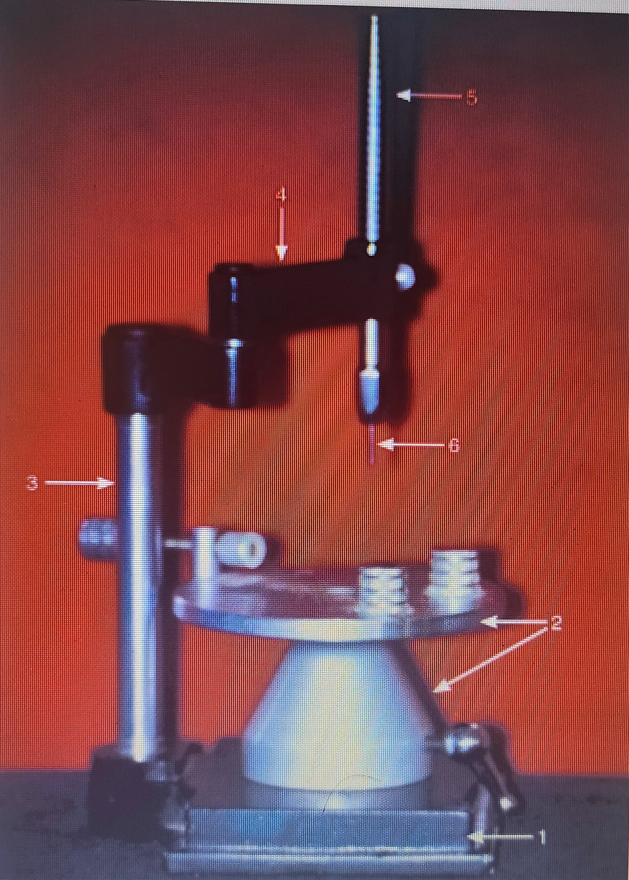
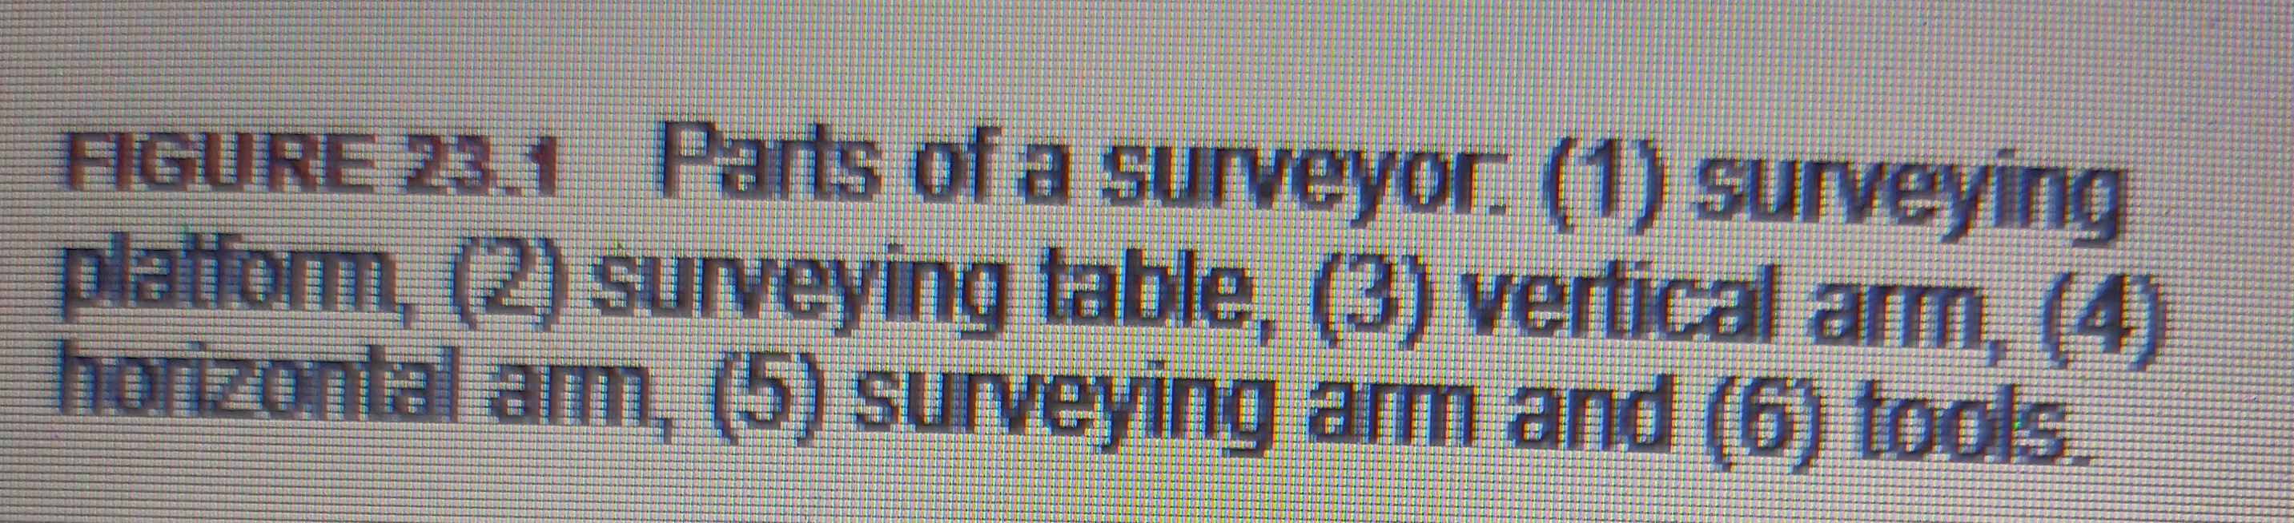

Slide 11
Parts
1. Surveying platform: It is a metal base parallel to the floor onto which a cast holder and vertical arm are attached
2.Surveying table: This consists of a base and cast holder. The base sits on the platform and cast holder is attached to it. The cast to be surveyed can be secured to this holder. The holder is attached to the base with a ball and socket joint that permits the cast to be oriented in various horizontal planes so that the axial surfaces of the teeth and soft tissue areas of the cast can be analysed in relation to the vertical plane.

Slide 12
parts
3. Vertical arm: This is attached to the platform and supports the horizontal arm.
4. Horizontal arm : This extends at right angles to the vertical arm and the surveying arm is attached to it. The Ney, Jelenko and Williams surveyors differ in this aspect as mention.
5. Surveying arm : It drops vertically from the free end of the horizontal arm. It can be moved vertically up and down. The Mandrel, which holds the surveying tools, is attached to its lower end. This arm is spring loaded in Jelenko surveyor, while it is passive in the Ney surveyor.

Slide 13
parts
6. Surveying tools : These are held by the mandrel attached to surveying arm . The tools are analysing rod, carbon marker, undercut gauges and wax trimmer.
i. Analysing rod: It is the first tool used in surveying. It is a cylindrical metal rod that contacts the convex surface of the teeth to be analysed, like a tangent contacting a curve, thereby locating the height of contour. It helps determine the relative parallelism of one surface to another and hence is also called as paralleling tool . It also makes an initial assessment of the path of insertion.

Slide 14
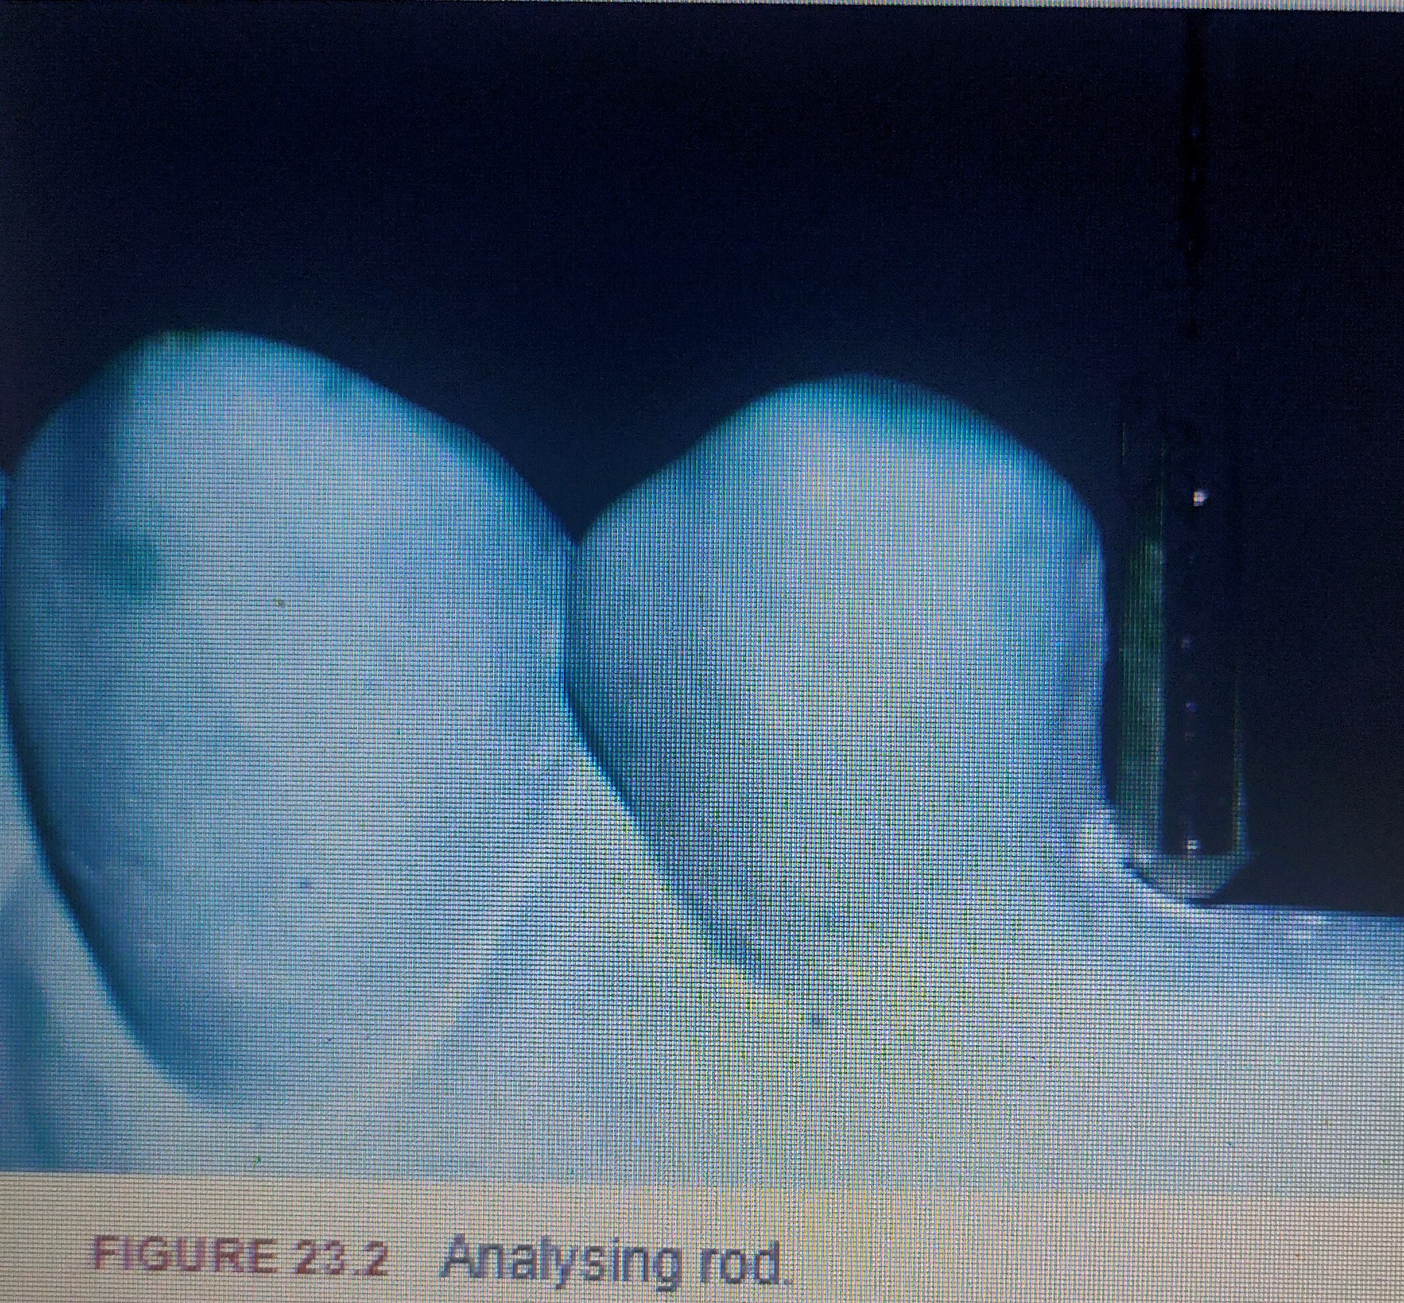

Slide 15
parts
ii. Carbon marker: It is similar to lead points in a pencil. It is used to draw the ‘survey line’ by contacting the teeth similar to the analysing rod . They are circular in cross-section in Ney surveyors and triangular in Jelenko surveyors.
iii. Undercut gauges: Used to determine the amount and location of retentive undercut on the surface of an abutment tooth. It consists of a vertical rod attached to the centre of a circular metal plate. While the rod contacts the height of contour, the circular projection contacts the undercut . The size of projection can vary giving the exact amount of undercut. Generally, it comes as 0.010, 0.020, 0.030 inch gauge.

Slide 16
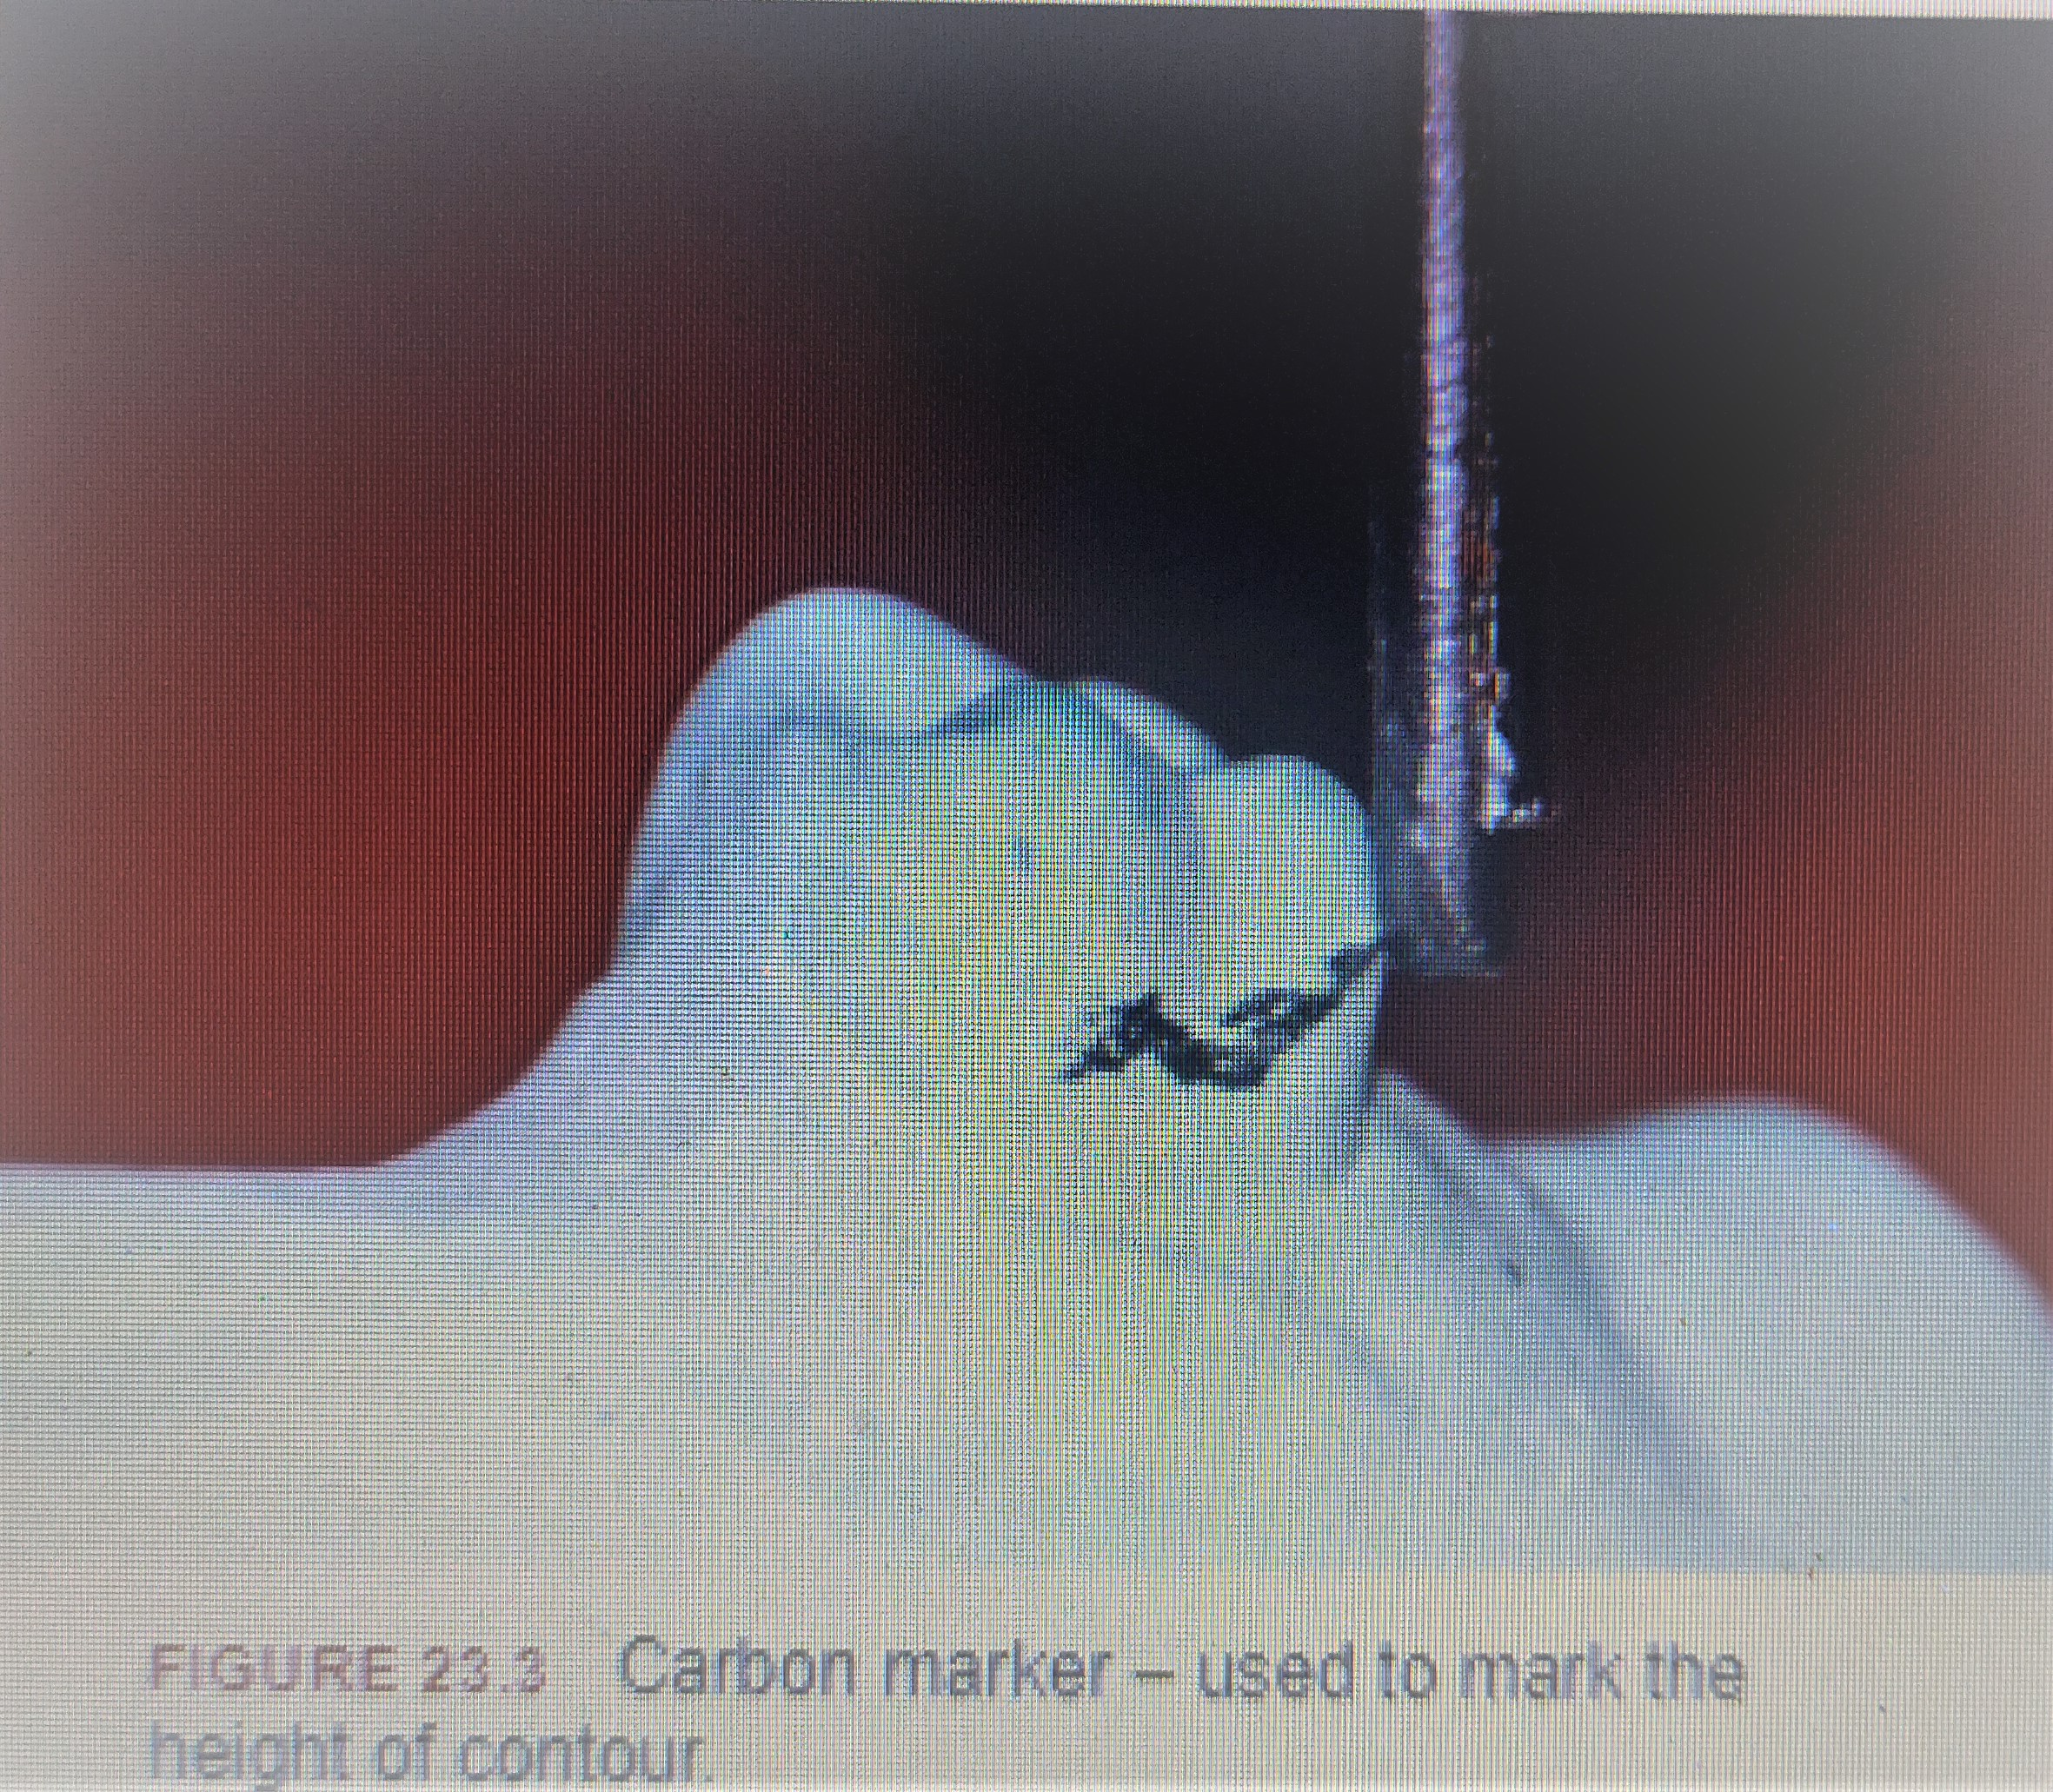

Slide 17
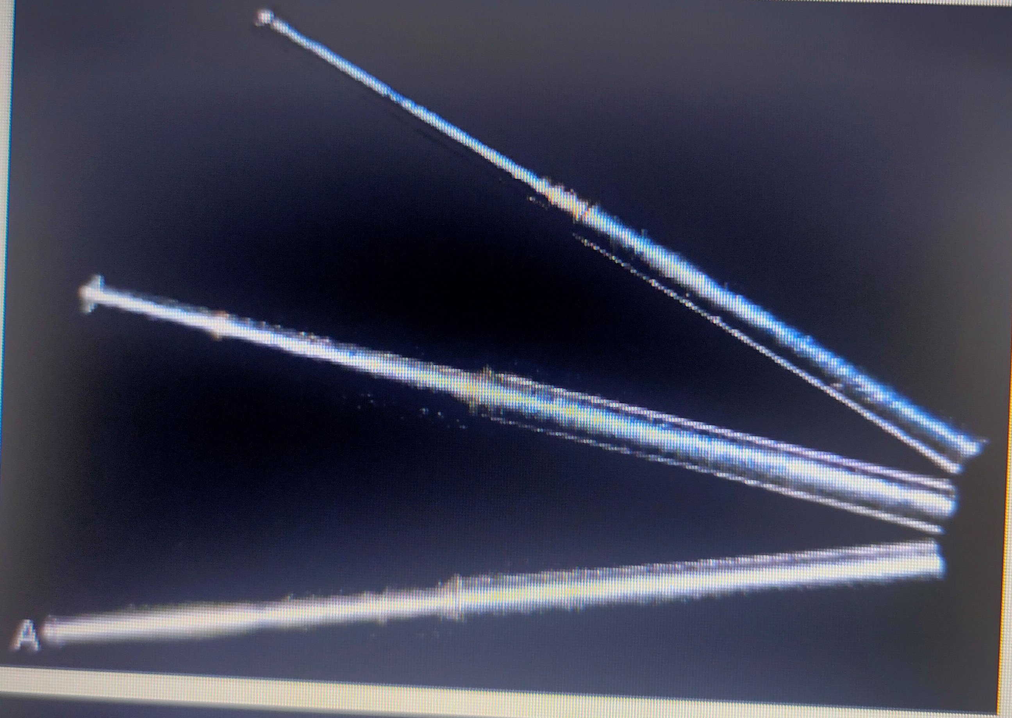

Slide 18
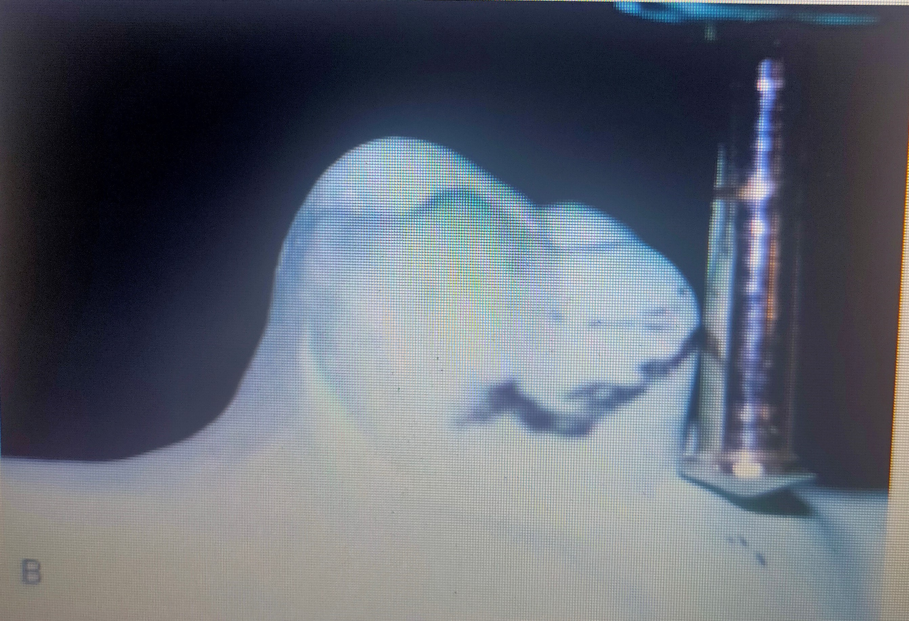

Slide 19
parts
iv. Wax trimmer: Used to trim excess wax from block out areas to make them parallel to path of insertion and to trim waxed crown restorations to desirable path of insertion

Slide 20
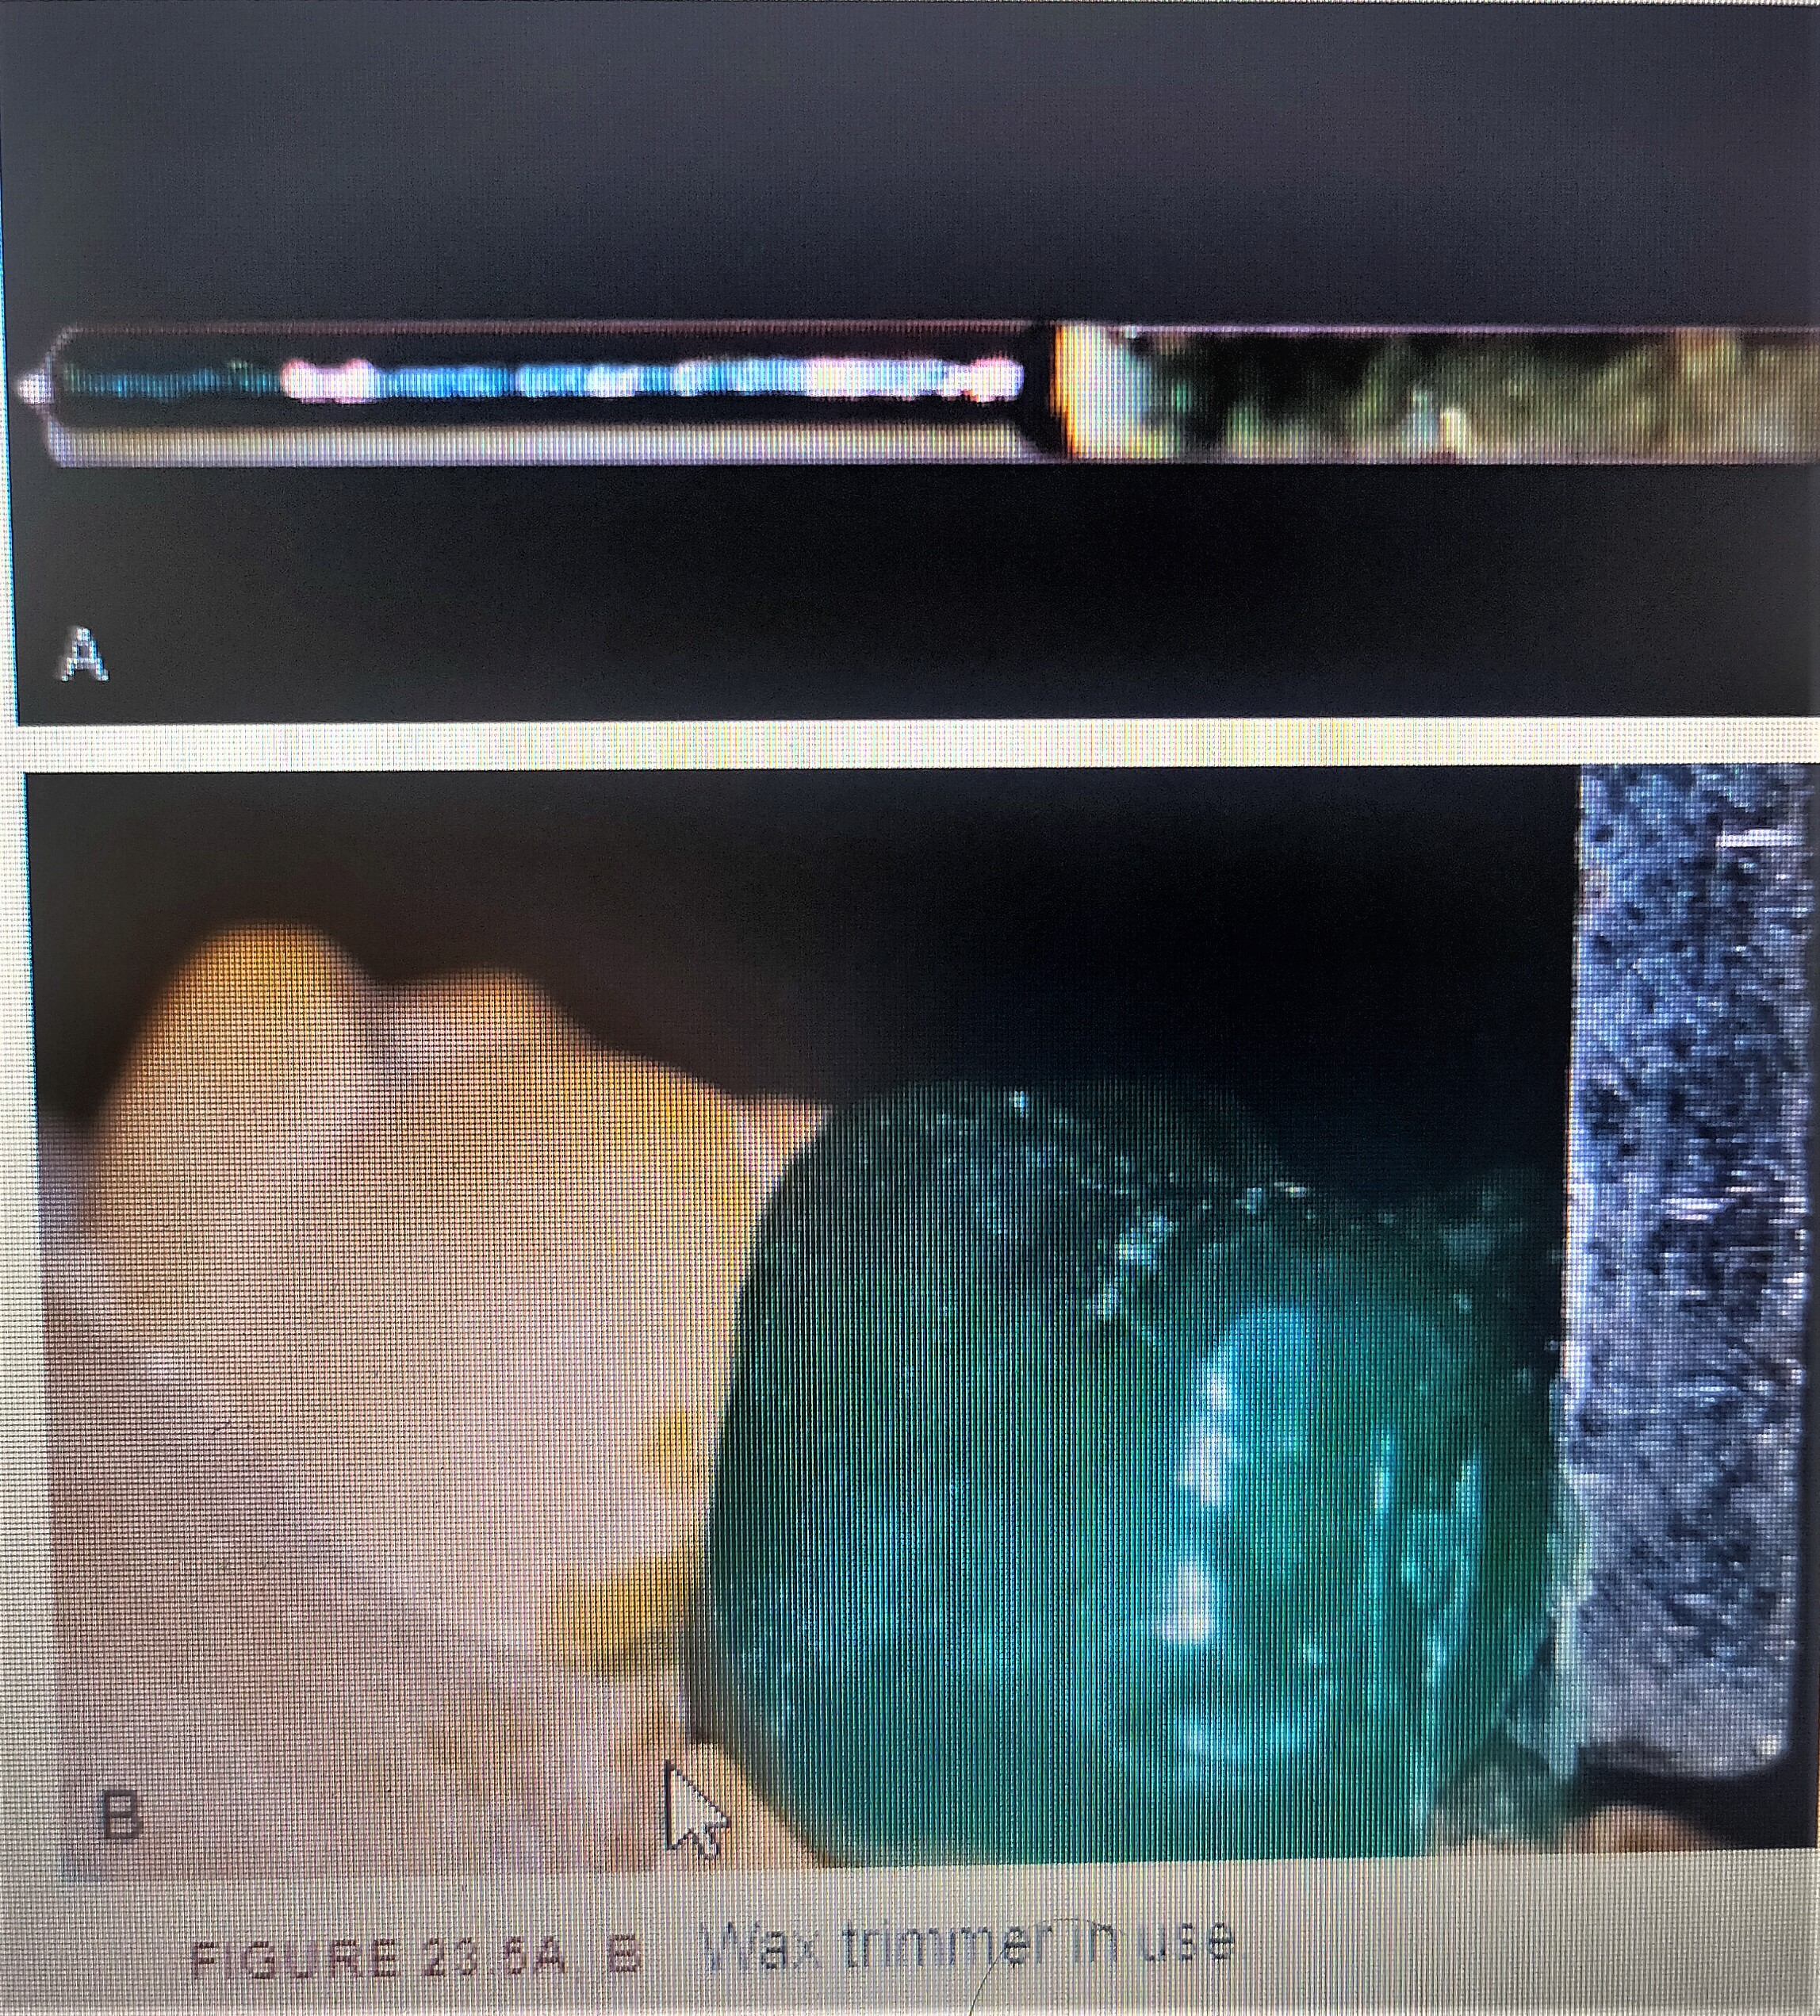

Slide 21
Uses/purposes of surveyor
1. Surveying the diagnostic cast
2. Tripoding
3. Surveying the master cast
4. Contouring wax patterns
5. Contouring crowns
6. Placing internal attachments
7. Placing internal rests

Slide 22
1.Surveying the diagnostic cast
First the diagnostic cast is surveyed to basically determine ‘the path of insertion’ or the most favourable tilt. The factors that influence this are :
1. Retentive undercuts
2. Interferences
3. Aesthetics
4. Guide planes

Slide 23
2.Tripoding
After the path of insertion or final tilt of cast is selected, it must be recorded on the diagnostic cast. This enables the cast to be oriented back on the surveyor in the same position. This procedure of recording the position is called tripoding. The tripod marks are also transferred to the master cast, so that it can also be positioned similarly.

Slide 24
3. Surveying the master cast
The master cast is tripoded in the same position as diagnostic cast by tripoding. It is surveyed to perform the following procedures:
1. Beading
2. Block out
3. Relief

Slide 25
4. Contouring wax patterns
• This is performed by the surveying tool – the wax trimmer.
• Indicated when the proposed abutment needs to be crowned.
• When the wax pattern of the crown is prepared, the working cast is placed on the surveyor in the same position as diagnostic cast, using tripoding.
• Guiding planes on all proximal surfaces of wax patterns adjacent to edentulous areas should be made parallel to the determined path of insertion.
• The height of contour of the wax pattern may also be adjusted to get the right amount of undercut for the placement of retention and reciprocal clasp arms.

Slide 26
5. Contouring crowns
The established contours on wax patterns undergo some degree of change following casting procedures and ceramic application.
To re-establish the original height of contour and guide plane as developed in the wax pattern, the working cast with the metal crown or unglazed ceramic crown is returned to the surveyor in the same orientation using tripoding and the contour is refined.
• This is performed by attaching a handpiece holder to the surveying arm.
This holder then suspends a straight handpiece onto which mounted cylindrical stones are attached.
The guiding planes can be refined by moving the surveying table so that the mounted stone contacts the guiding plane of crown or restoration.
Final finishing and polishing or glazing is performed after this.

Slide 27
6. Placing internal attachments
The surveyor may be used to position intracoronal retainers or internal attachments along the path of insertion in the wax crown pattern of abutment teeth, as the patterns are being formed.
Absolute parallelism among the attachments is necessary.
The surveyor is first used to verify the space available in the abutment by making a recess in the stone abutment teeth on diagnostic cast.
If space is adequate (without any pulpal encroachment), a recess is carved in wax pattern and attachment is placed.
The path of insertion is again verified after casting by using the surveyor.

Slide 28
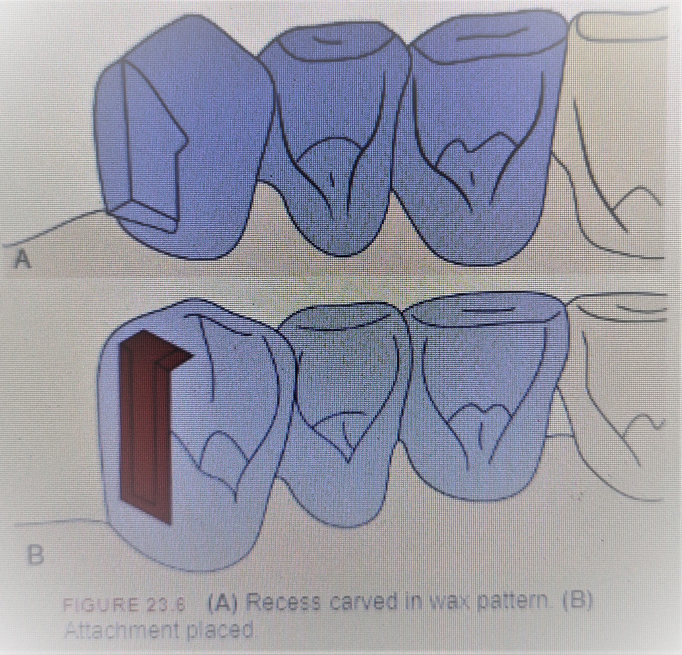

Slide 29
7.Placing internal rests
These are box-shaped exaggerated occlusal rests with vertical walls and flat floors.
They can be created in the wax patterns of abutments crowns, in harmony with the path of insertion, by using the straight handpiece of surveyor with appropriate tools.
• It provides good support and stabilization.
Depending on the taper of the walls, retention can be controlled.
It is contraindicated with distal extension base partial dentures as more torque is applied to the abutment using this interlocking rest.

Slide 30
Surveying -The surveying procedure usually involves the following procedures.
Surveying diagnostic cast
Interferences
Aesthetics
Guiding planes
Tripoding or tripod marking
Transferring tripod marks to another cast
Survey of master cast
Relief

Slide 31
Surveying diagnostic cast This is done before the treatment plan is formulated.
The main objective of surveying the diagnostic cast is to determine the most desirable path of placement (insertion) that will eliminate or minimize the interference to the placement and the removal of prosthesis.
This basically involves determining the most favourable tilt of the cast with respect to various factors involved in determining the path of placement.

Slide 32
Summary
The main objective of surveying the diagnostic cast is to determine the most desirable path of placement (insertion) that will eliminate or minimize the interference to the placement and the removal of prosthesis

Slide 33
Take home message
The main objective of surveying the diagnostic cast is to determine the most desirable path of placement (insertion) that will eliminate or minimize the interference to the placement and the removal of prosthesis

Slide 34
References
Removable partial prosthodontics 11th edition Mc cracken
Clinical removable partial prosthodontics stewarts
A color atlas of removable partial dentures J.C. Davenport ; R.M. Basker
Advanced Removable Partial Dentures James S. Brudvik
Arthur M. LaVere, and Arthur J. Krol, Selection of a maior connector for the extension-base removable partial denture JPD 1973;30,102-105
Davis Hendersonand Thomas E. Seward Design and force distribution with removable partial dentures: A progress report JPD 1967;17,350-364.

